Slide 1

COMM223 Marketing Management
Lecture 10 - IMC

Slide 2
Agenda
Integrated marketing communication
Advertising

Slide 3
Where are we now …
Company
Company Analysis
Competitor Analysis
Consumer Analysis
Marketing Management
Competitor
Consumer
Product
Promotion
Price
Distribution
Product - Market

Slide 4
The Marketing Communications Mix
A promotion mix, or marketing communications mix, is a specific blend of promotion tools:
Advertising
Sales promotion
Personal selling
Public relations (PR)
Direct and digital marketing

Slide 5
The Marketing Communications Mix
Advertising:
Any paid form of non-personal presentation and promotion of ideas, goods, or services by an identified sponsor
Sales promotion:
Short-term incentives to encourage purchase or sale of a product or service
Public relations:
Building good relations and corporate image with the company’s publics using publicity, and handling unfavourable events
Personal selling:
Personal presentation by the firm’s sales force for the purpose of making sales and building customer relationships
Direct marketing:
Direct communications with targeted individuals to obtain an immediate response and lasting customer relationships

Slide 6
Integrated Marketing Communications
Factors changing the face of today’s marketing communications:
Changing consumers
Changing marketing strategies
Advancements in digital technology

Slide 7
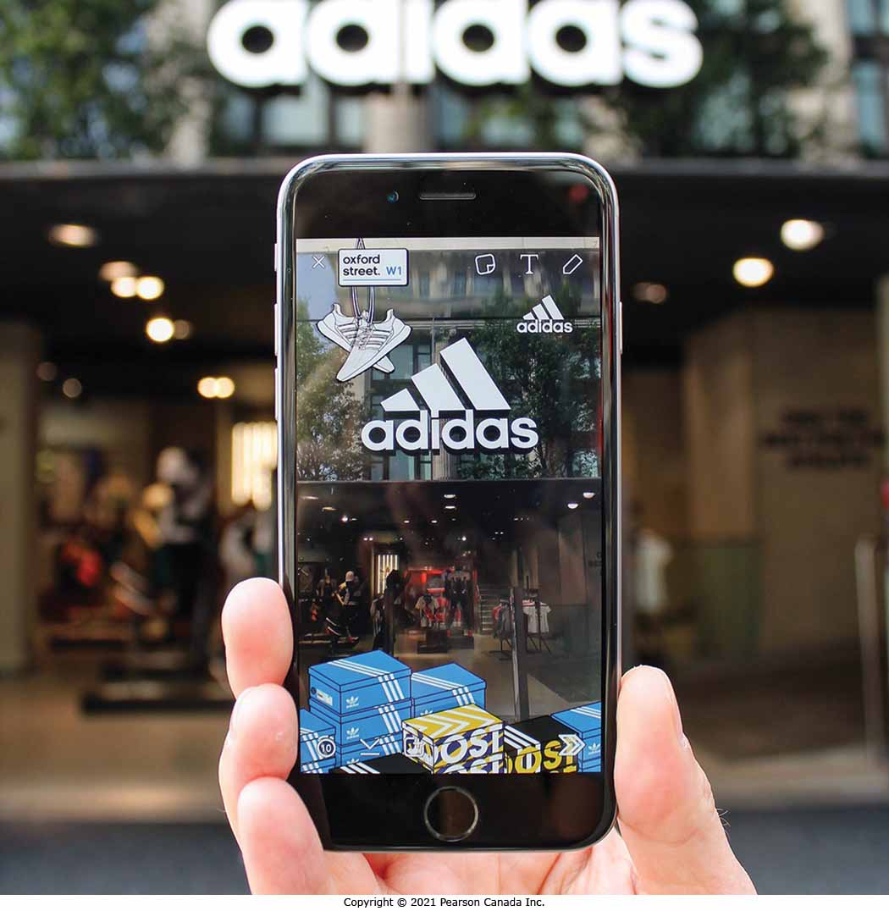
Integrated Marketing Communications
Adidas now uses only digital channels to engage its younger consumers.

Slide 8
Integrated Marketing Communications
Marketers reach smaller consumer segments in interactive and engaging ways.
Mix of traditional mass media and a wide array of online, mobile, and social media
Content marketing managers create, inspire and share brand messages and conversations.
营销人员以互动和引人入胜的方式接触较小的消费者群体。
传统大众媒体与各种在线、移动和社交媒体的混合
内容营销经理创建、激发和分享品牌信息和对话。

Slide 9
Integrated Marketing Communications
The Need for Integrated Marketing Communications
Conflicting messages from different sources or promotional approaches can confuse company or brand images来自不同来源或促销方式的冲突信息可能会混淆公司或品牌形象
The problem is particularly prevalent when functional specialists handle individual forms of marketing communications independently当职能专家独立处理个别形式的营销传播时，这个问题尤其普遍

Slide 10
Integrated Marketing Communications
Integrated Marketing Communications
The concept under which a company carefully integrates and coordinates its many communications channels to deliver a clear, consistent, and compelling message about the organization and its products.公司在此概念下仔细整合和协调其众多沟通渠道，以传达有关组织及其产品的清晰、一致和引人注目的信息。

Slide 11
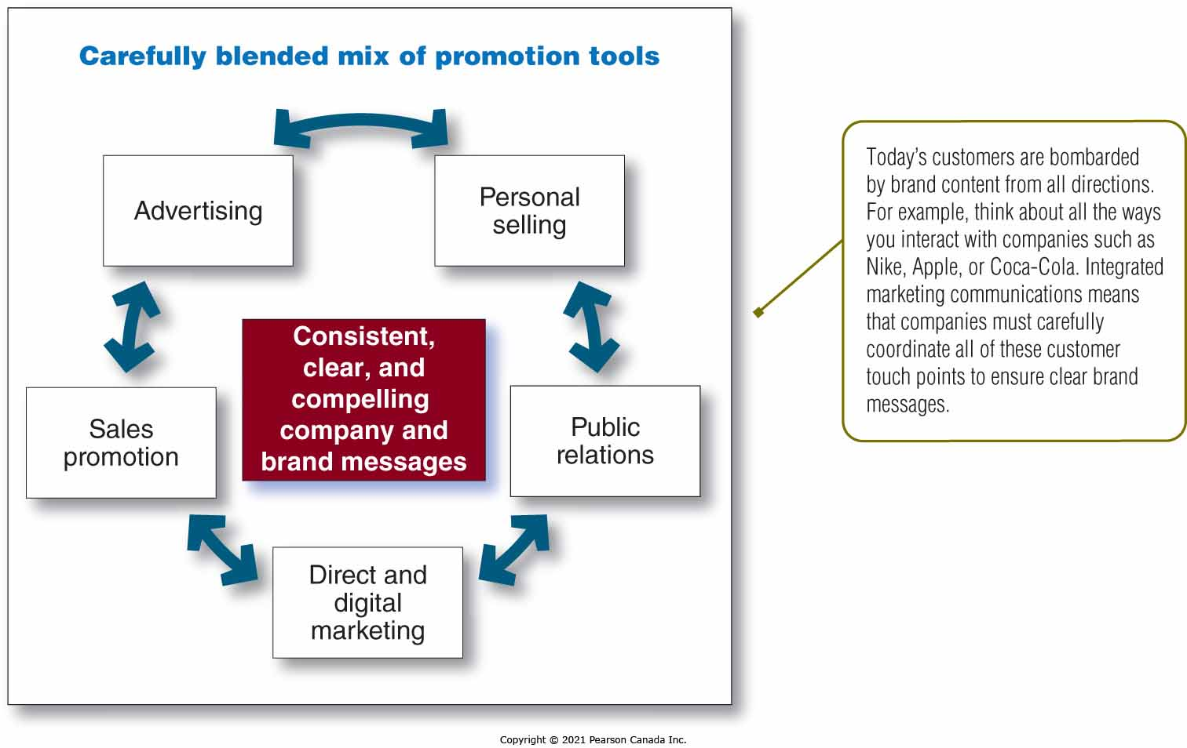
Integrated Marketing Communications

Slide 12
Shaping the Overall Communication Mix
Determined by the nature of each promotion tool and the selected promotion mix strategy

Slide 13
Nature of the Promotion Tools
Promotion tool | Description
Advertising | Reaches masses of buyers at a low cost per exposure Builds a long-term image for a product Can trigger quick sales Has a public nature and is viewed as legitimate Very expressive Impersonal and lacks the direct persuasiveness of salespeople
Personal selling | Personal interaction between two or more people Allows all kinds of customer relationships to spring up Buyer feels a greater need to listen and respond Most expensive promotion tool

Slide 14
Nature of the Promotion Tools
Promotion tool | Description
Sales promotion | Wide assortment of tools with unique qualities Attracts attention and offers incentives to purchase Used to dramatize product offers and boost sales Invites and rewards quick response but has short-lived effects
Public relations | Very believable to readers Can dramatize a company or product Reaches many prospects Effective and economical when well thought out
Direct and digital marketing | More targeted and interactive Immediate and personalized

Slide 15
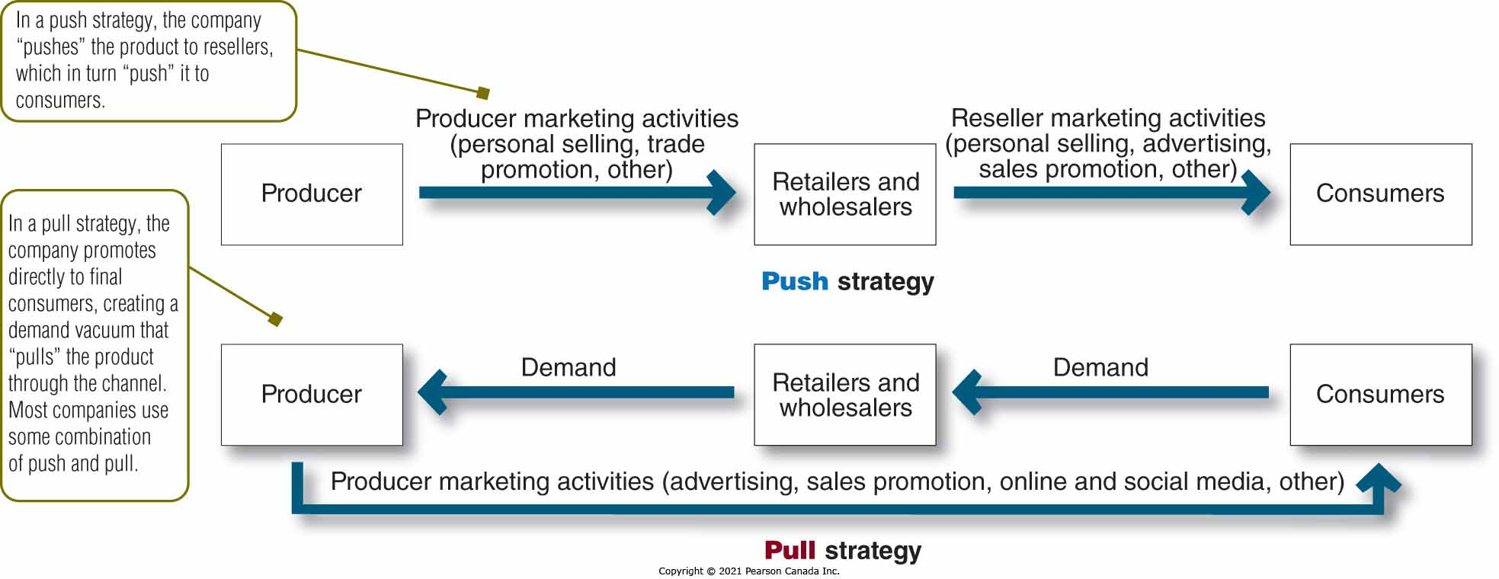
Push vs. Pull Promotion Strategy

Slide 16
Advertising
Advertising
Any paid form of nonpersonal presentation and promotion of ideas, goods, or services by an identified sponsor.
Business firms, not-for-profit, social agencies, and professionals all advertise
由特定赞助商进行的任何有偿形式的非个人展示和宣传创意、商品或服务。
商业公司、非营利组织、社会机构和专业人士都在做广告

Slide 17
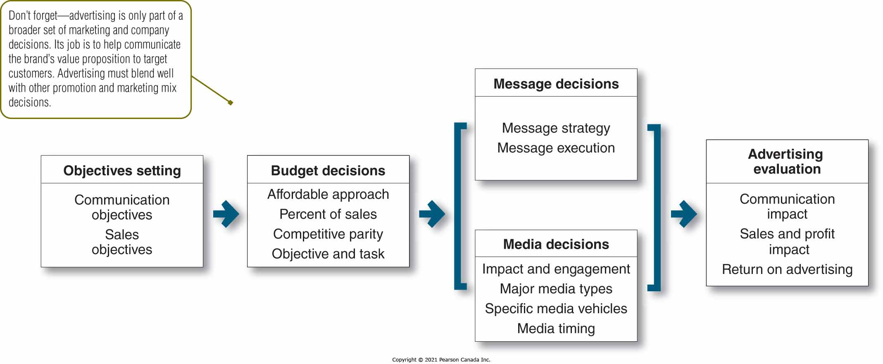
Major Advertising Decisions

Slide 18
Key Advertising Decisions
Setting objectives
Setting the budget
Developing the advertising strategy
Evaluating advertising campaigns
Advertising objectives can be classified by primary purpose:
Inform
Introducing new products通知
推出新产品
Persuade
Becomes more important as competition increases
Comparative advertising
Remind
Most important for mature products

Slide 19
Possible Advertising Objectives
Informative Advertising
Communicating customer value | Suggesting new uses for a product
Building a brand and company image | Informing the market of a price change
Telling the market about a new product | Describing available services and support
Explaining how a product works | Correcting false impressions
Persuasive Advertising
Building a brand preference | Persuading customers to purchase now
Encouraging switching to a brand | Creating customer engagement
Changing customer perceptions of product value | Building brand community
Reminder Advertising
Maintaining customer relationships | Reminding consumers where to buy the product
Reminding consumers that the product may be needed in the near future | Keeping the brand in a customer’s mind during off-seasons

Slide 20
Key Advertising Decisions
Setting objectives
Setting the budget
Developing the advertising strategy
Evaluating advertising campaigns
Affordable method
Percentage-of-sales method
Competitive-parity method
Objective-and-task method

Slide 21
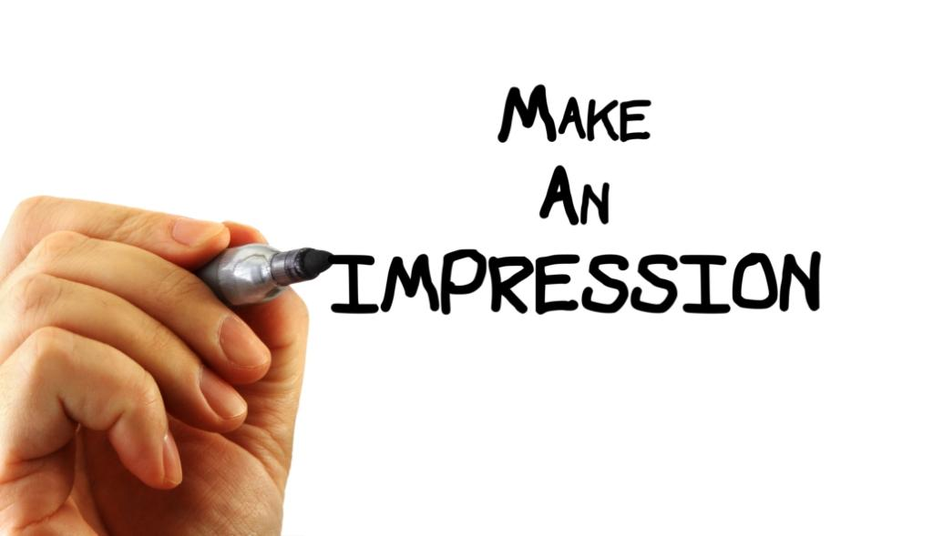
Key Advertising Decisions
Setting objectives
Setting the budget
Developing the advertising strategy
Evaluating advertising campaigns
Accomplishes the company’s advertising objectives
Creating ad messages
Breaking through the clutter
Merging advertising and entertainment
Message and content strategy
Message execution
Consumer-generated content

Slide 22
Advertising
Creative Execution Styles
Slice of Life
Lifestyle
Fantasy
Mood or Image
Musical
Testimonial Evidence or Endorsement
Personality Symbol
Technical Expertise
Scientific Evidence

Slide 23
Key Advertising Decisions
Setting objectives
Setting the budget
Developing the advertising strategy (cont.)
Evaluating advertising campaigns
Select advertising media选择广告媒体
Decide on level of reach, frequency, impact and engagement确定覆盖范围、频率、影响和参与度
Choose among the major media types by considering:通过考虑以下因素在主要媒体类型中进行选择：
Consumer media habits, nature of the product, types of messages, and costs 消费者媒体习惯、产品性质、信息类型和成本
Select specific media vehicles
Decide on media timing
选择特定的媒体工具
决定媒体时间

Slide 24
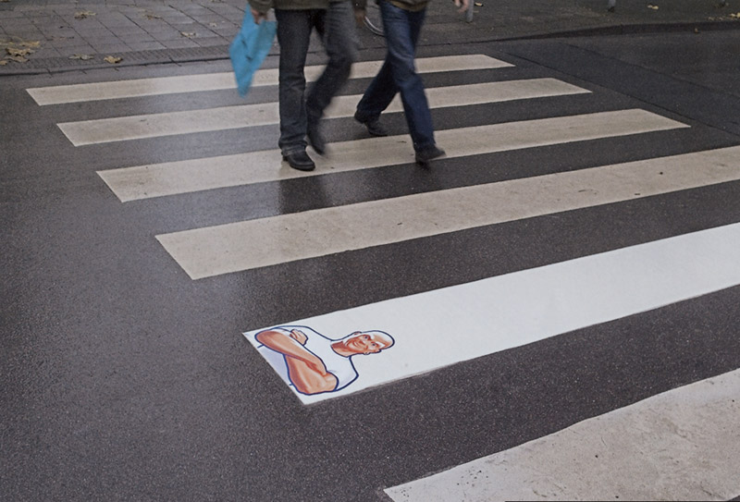
Advertising
Major Media Types
Newspapers
Television
Direct Mail
Digital, mobile, and social media
Magazines
Outdoor
Radio

Slide 25
Profiles of Major Media Types
Medium | Advantages | Limitations
Television | Good mass-marketing coverage; low cost per exposure; combines sight, sound, and motion; appealing to the senses | High absolute costs; high clutter; fleeting exposure; less audience selectivity
Digital, mobile, and social media | High selectivity; low cost; immediacy; engagement Capabilities | Potentially low impact; high audience control of content and exposure
Newspapers | Flexibility; timeliness; good local market coverage; broad acceptability; high believability | Short life; poor reproduction quality; small pass-along audience.
Direct mail | High audience selectivity; flexibility; no ad competition within the same medium; allows personalization | Relatively high cost per exposure; “junk mail” image.

Slide 26
Profiles of Major Media Types
Medium | Advantages | Limitations
Magazines | High geographic and demographic selectivity; credibility and prestige; high-quality reproduction; long life and good pass-along readership | Long ad purchase lead time; high cost; no guarantee of position
Radio | Good local acceptance; high geographic and demographic selectivity; low cost. | Audio only; fleeting exposure; low attention (“the half-heard” medium); fragmented audiences
Outdoor | Flexibility; high repeat exposure; low cost; good positional selectivity | Little audience selectivity; creative limitations

Slide 27
Key Advertising Decisions
Setting objectives
Setting the budget
Developing the advertising strategy (cont.)
Evaluating advertising effectiveness
Return on advertising investment: Net return on advertising investment divided by the costs of the advertising investment
Advertisers should regularly evaluate
Communication effects
Sales and profit effects

Slide 28
Read Chapter 12, 13 & 14

